Slide 1


Abstra
Lazar Milicevic
Weekly support report
Support, Challenges, Sollutions
24.04.2025

Slide 2
Agenda
1. Zendesk Ticket Management & Optimization
3. Infra & Product Coordination
5. Visual & Helpdesk Improvements
7. Q&A
2. FullStory & Dashboard Updates
4. Reported & Tracked Issues
6. Next Steps

Slide 3

Zendesk Support & Performance Update
Customer success: Weekly Support Report – 24.04.2025
What was done:
✅ Rotated Active Agents – Weekly squad rotation completed.
✅ AWS Zendesk Ticket Monitoring – Ongoing tracking of AWS-related tickets.
✅ Created dedicated Zendesk view to track k-signup-request tickets
✅ Set up technical API account and assigned Admin role
✅ Implemented two Zendesk triggers for welcome messages:
General welcome for Abstra users
Personalized welcome for Owkin K users (includes Help Center link)
✅ Messages are sent via email and don’t affect First Response Time ✅ Created Zendesk account and assigned Agent license to Ness Tchenio
Onboarding session scheduled for April 24 at 15:30 CET
✅ Access request submitted to Security team for two CHUV users (requested by Carla Haigneré)
🚀 Focus: Continuous automation & faster support response times.

Slide 4
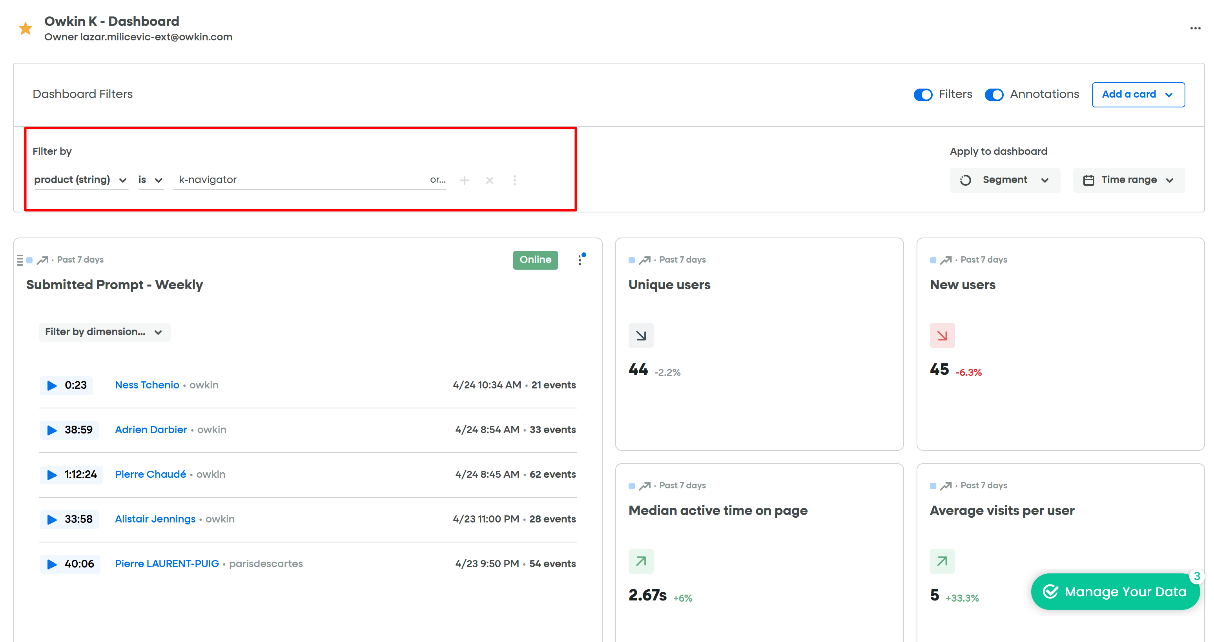
FullStory & Dashboard Updates
Customer success: Weekly Support Report – 24.04.2025
Where we are now ?
✅ Added key widgets to the Owkin K dashboard:
Visited homepage
Signed-up users
% of users with more than one session
Average session length
Chat history usage
Top users report
✅ Worked with FullStory support to configure advanced session metrics
✅ Requested quote to potentially split Owkin K into a separate FullStory account
✅ Advised internal team to always apply custom filters before analyzing data (to exclude irrelevant sessions)

Slide 5
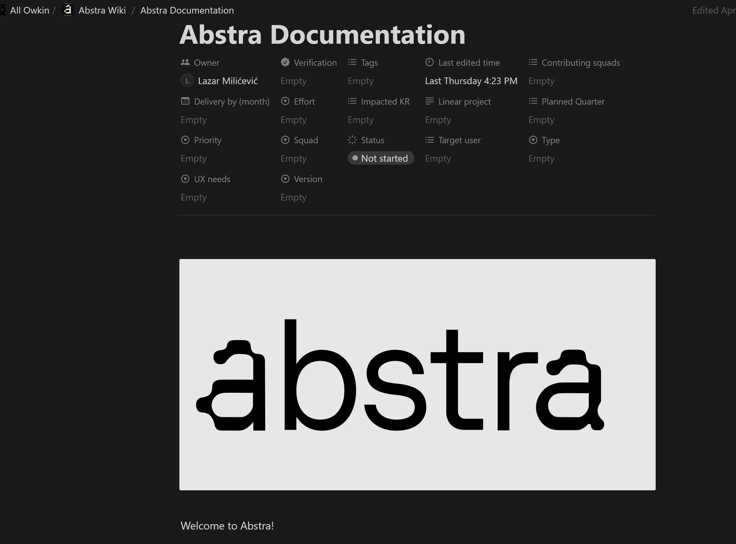
Infra & Product Coordination
Customer success: Weekly Support Report – 24.04.2025
Where we are now ?
✅ Completed migration of Abstra documentation to Notion
New structure with toggle lists for better readability
Link to Notion page shared internally
Currently working on migrating visuals (images/videos)
✅ Improving onboarding process for external users:
Collected emails, VPN IPs, and institution info
IP whitelisting and account creation pending Security approval

Slide 6
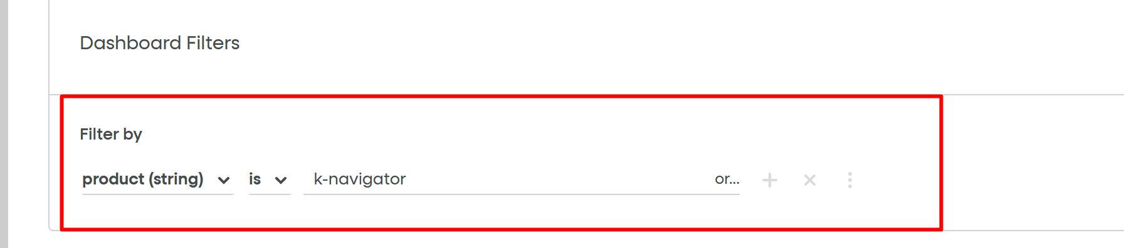
Reported & Tracked Issues
Customer success: Weekly Support Report – 24.04.2025
Some of them:
✅ FullStory parameter instability issue identified
Custom parameters intermittently missing from session data
Ticket opened with FullStory support (fix pending)
Internal reminder shared to verify parameter status before analysis
✅ SurveySparrow invoice issue identified
Forwarded to Sophie Zheng and escalated due to live widget in Owkin K production

Slide 7

Visual & Helpdesk Improvements
Customer success: Weekly Support Report – 24.04.2025
✅ Help Center updates completed:
Public access enabled
FAQ section redesigned
SurveySparrow questions updated
MOSAIC dataset description added
Promoted articles refreshed
✅ Coordinated FAQ restructuring with Émilie Boissady
Updated entries: Sharing results, Access control, Password reset, Data sources, Data analysis requirements

Slide 8
Next Steps
Customer success: Weekly Support Report – 24.04.2025
?
Monitor FullStory dashboard daily and validate filtering logic
Evaluate impact of new widgets on session tracking and conversion insights
Finalize visual migration of Abstra documentation in Notion
Follow up on FullStory ticket related to parameter stability
Confirm payment resolution for SurveySparrow subscription
Continue CHUV onboarding once Security gives the green light

Slide 9

Q&A
Customer success: Weekly Support Report – 24.04.2025
?

Slide 10
Thank you!

